Slide 1
Quantitative Portfolio Optimization
Team NAPPERS

Slide 2
Summary
Goal: Develop an end-to-end portfolio optimization pipeline that constructs monthly, long-only equity portfolios on an S&P 500–like universe and evaluates them against simple benchmarks using strictly out-of-sample performance.
Current Project Scope:
Focuses on monthly, long-only, fully-invested equity portfolios; excludes leverage, shorting, options, and intraday trading.
Restricts evaluation to historical backtests on the sp500_monthly sample
Includes infrastructure, testing, and documentation as primary goals so that future extensions (e.g. new signals, risk models, or universes) can plug into the same framework.

Slide 3
Objective
This objective balances four components:
Expected return: rewards allocations toward assets with higher estimated mean returns (estimated from rolling historical data).
Risk penalty​: penalizes portfolio variance, with γ\gammaγ controlling risk aversion.
Weight regularization​: discourages extreme or highly concentrated allocations by penalizing large absolute weights.
Turnover penalty​: penalizes deviations from last month’s portfolio, serving as a proxy for transaction costs and encouraging stability over time.

Slide 4
Data
Sourced from Wharton Research Data Services (WRDS)
S&P 500 monthly data (2000 - present)
Useful fields include: date, ticker, price, return, shares outstanding, SIC codes
Pros:
Dataset is cleaned and reputable
Long historical coverage (25+ years of monthly data
Breadth of data (returns are pre-calculated, outstanding shares and volume included)
Cons:
Limited in scope beyond straightforward applications of portfolio optimization
Huge dataset - computationally expensive, could lead to overfitting
Access limitation - potentially leads to complications with theoretical distribution/real-world implementation of model
Moving forward:
As project advances, we may need to acquire supplementary data - finer or coarser grain date-wise depending on eta
In order to differentiate from previous project, may need to search for more niche dataset to narrow our application (ESG, alternate optimization strategy such as a two layer model or higher moments)

Slide 5
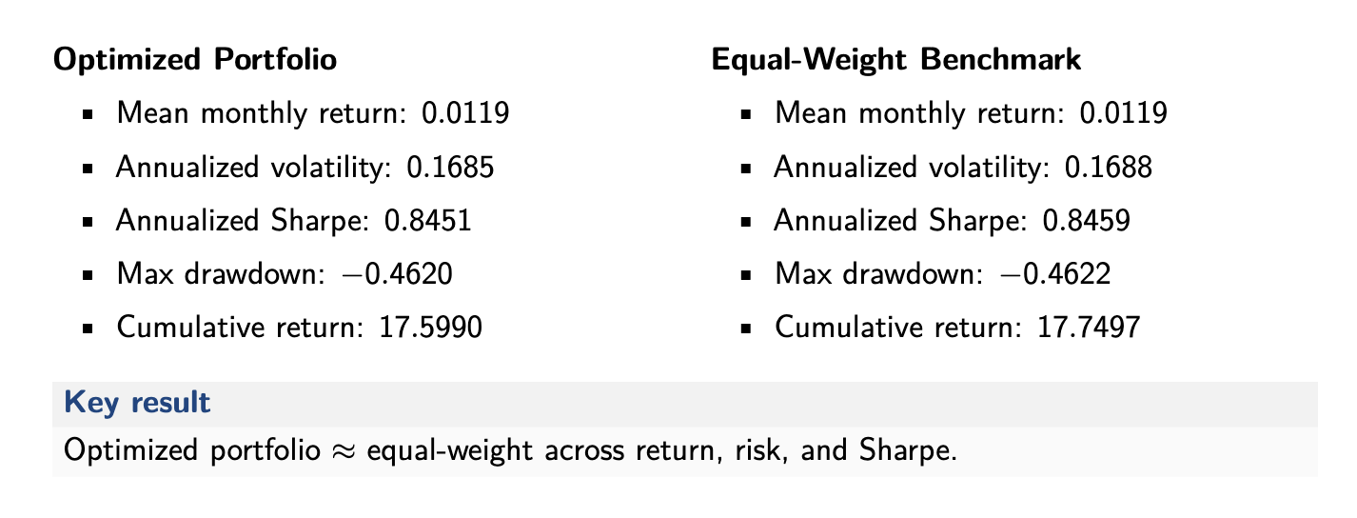
Preliminary Results

Slide 6
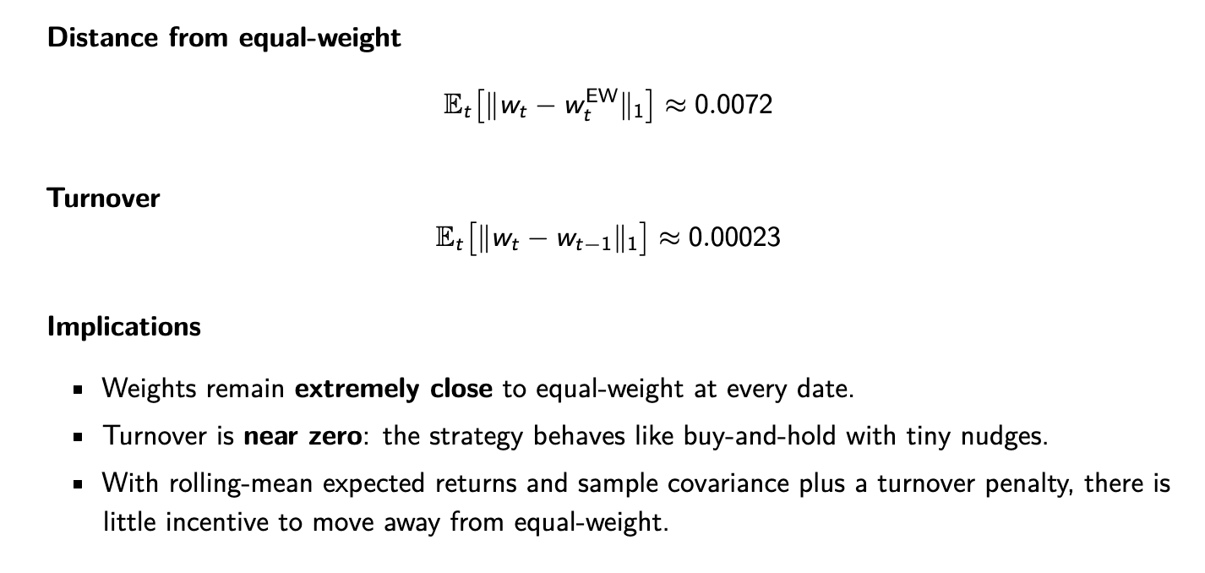
Preliminary Results

Slide 7
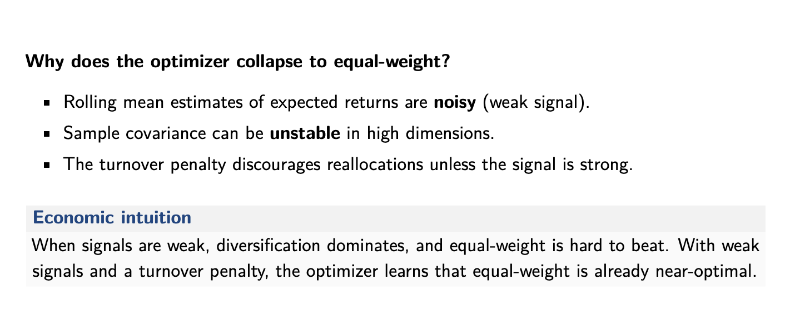
Preliminary Results

Slide 8
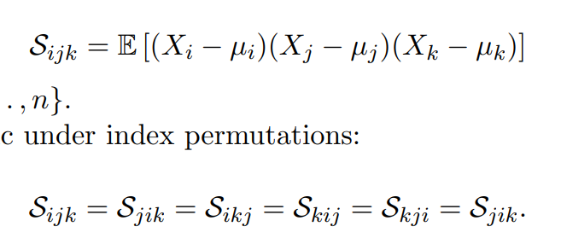
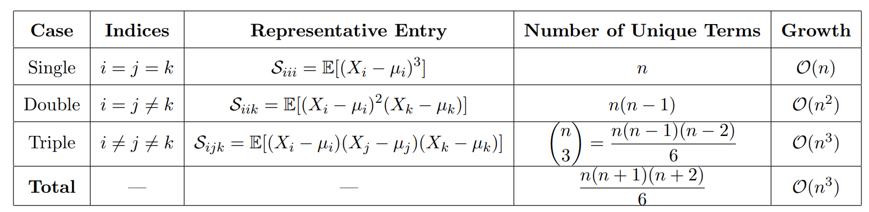
Exploration: Skew Tensor

Slide 9
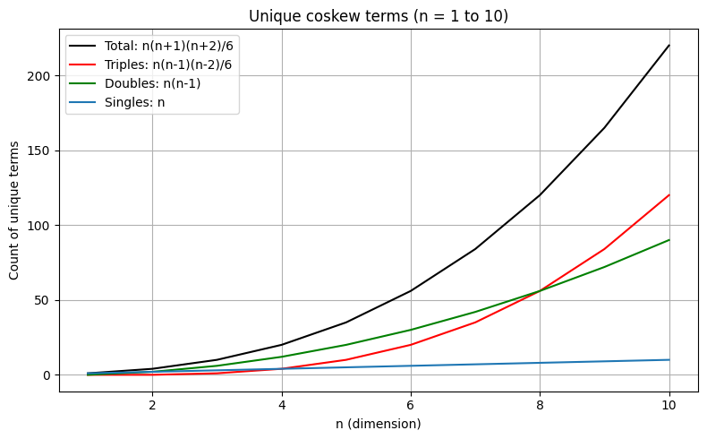
Exploration: Skew Tensor 2
As dimensionality increases, the structure of coskewness becomes overwhelmingly dominated by
triple-variable interactions.
This has implications for:
• Storage complexity,
• Estimation stability,
• Regularization needs,
• Dimensionality reduction strategies.

Slide 10
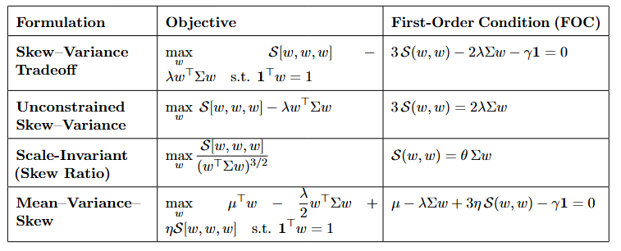
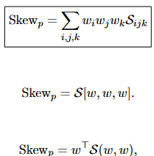
Exploration: Skew Tensor 3
For portfolio optimization we want to maximize the portfolio skew at the cost of portfolio variance, where portfolio skew is defined by the contraction of the tensor over the weight indices.

